Slide 1

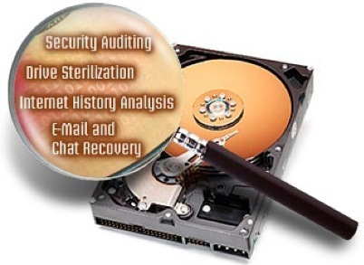
DF
LECTURE
Computer Forensics & Digital Evidences
Digital Forensics
Diploma in CSF/IT
Year 2/3 (2022/23), Semester 4/6
1
Notes:
Left-hand Bar – Replace FSP by your module code and X by the lecture number.
Replace Lecture Title
Replace < Module Name >
Replace Year and Semester if necessary

Slide 2
Objectives
At the end of this, you will get to know more about:
The background and scope of computer forensics
3 stages in Forensic investigation
What is Digital Evidence?
Categories of Forensic Data
Persistent vs Volatile Data
Forensic Image
EnCase Evidence File (E01)

Slide 3
Background of Computer Forensics
Until the late 1990s, what became known as digital forensics was commonly termed ‘computer forensics’.
Dependency on computer has given way to new crimes.
Computers are either used as a tool to commit a crime or have become a target for these crimes.
Examples:
Computer Hacking
Data theft
Terrorism
Murder
Fraud
etc.

Slide 4
Background of Computer Forensics – cont.
Cyber crime encompasses any criminal act dealing with computers and networks. These include:
Hacking,
DoS or DDoS attacks,
Intrusion,
Sending unsolicited or virus-causing electronic mail.
Damage to or modifications of computer data or programs.
Unauthorized access to computers and programs.
etc.

Slide 5
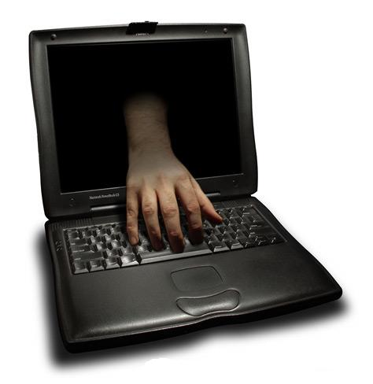
Background of Computer Forensics – cont.
Cyber crime also includes traditional crimes that are committed through the use of a computer and the Internet.
Examples:
Identity theft,
Data theft,
Internet fraud,
Counterfeit
Use of computers and printers to print checks, money orders etc.

Slide 6
Background of Computer Forensics – cont.
As most crimes nowadays involve digital content, computer forensics are commonly used to solve both cyber crimes and traditional crimes.
How computer forensics helped to solve crime? Let’s watch a video.
http://www.youtube.com/watch?v=NUSuMWR88Bk&feature=related

Slide 7
Objectives of Computer Forensics
To recover, analyze and present computer-based material in such a way that it can be presented as evidence in a court of law.
In computer hacking, computer forensics help to identify the evidence in short time, estimate potential impact of the malicious activity on the victim, and assess the intent and identity of the perpetrator.

Slide 8
Who performs Computer Forensics?
Practitioners of computer forensics can be any of the following:
Law enforcement for criminal cases.
Corporate IT security personnel for criminal or civil cases.
Corporate HR investigators for workplace investigations.
Private investigators for various investigations.

Slide 9
Definition
“the application of science to the identification, collection, examination and analysis of data while preserving the integrity of information and maintaining a strict chain of custody for the data”
NIST – Guide to integration Forensic Techniques into Incident Response”

Slide 10
What does Computer Forensics involve?
“Computer Forensics is the preservation, identification, extraction, interpretation, and documentation of computer evidence,
legal processes, integrity of evidence, factual reporting of the information found, and
providing expert opinion in a court of law or other legal and/or administrative proceeding as to what was found.”
Steve Hailey of Cyber Security Institute

Slide 11
What does Computer Forensics involve? – cont.
Preservation
The forensic investigator (FI) must preserve the integrity of the original evidence.
The original evidence should not be modified or damaged.
FI must make an image or a copy of original evidence and then perform his analysis.
He must also compare the copy with the original evidence to identify any modifications or damages.

Slide 12
Evidence Preservation - Hashing
It is necessary to prove that all evidences are exactly the same as the original data, down to the very last bit!
A hash function is any well-defined procedure or mathematical function for turning some kind of data into a relatively small integer.
The values returned by a hash function are called hash values, hash codes, hash sums, or simply hashes.

Slide 13
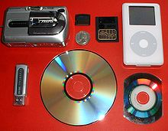
What does Computer Forensics involve? – cont.
Identification
The FI starts its investigation by identifying the evidence and its location.
E.g. evidence may be in desktops/laptops, servers, removable media(CD/DVD, thumb drive), mobile phone or network devices.
Locating and identifying information/data is a challenge for the FI.

Slide 14
What does Computer Forensics involve? – cont.
Extraction
Once the evidence is identified and located, the data should be extracted immediately.
Volatile data can be lost at any point of time, FI must extract these data from the copy he made from the original evidence.
The extracted data must be compared with original evidence and analyzed.

Slide 15
What does Computer Forensics involve? – cont.
Interpretation
The most important role of FI during investigations is to interpret what he has found.
The analysis and inspection of evidence must be interpreted in a lucid manner.
Documentation
Documentation relating to evidence must be maintained from the beginning of the investigation till the end.
This includes the chain of custody forms.

Slide 16
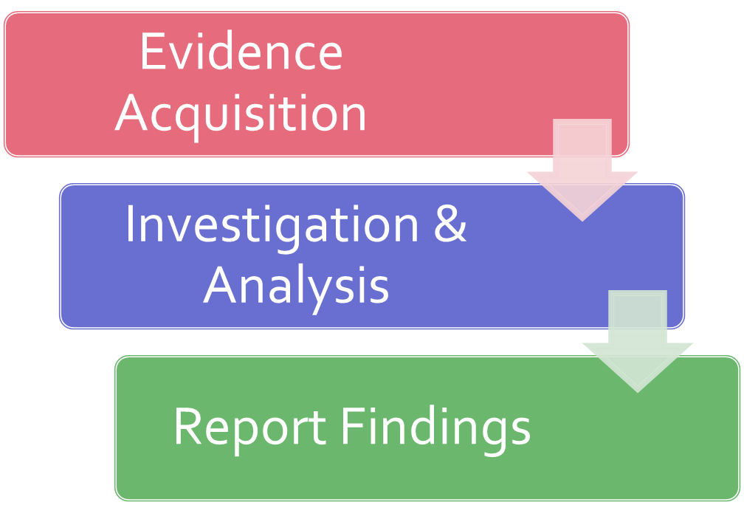
Forensics in a Nutshell

Slide 17
What is Digital Evidence? – cont.
Digital evidence is any probative information stored or transmitted in digital form that a party to a court case may use at trial.
Before accepting digital evidence a court will determine if the evidence is relevant and whether it is authentic.
Examples of digital evidences:
Emails
Digital Photographs
Word processing documents
Instant message histories
Internet browser histories
Content of Memory(RAM)

Slide 18
What is Digital Evidence?
Digital evidence may be found in hard disk drive, RAM, mobile phones, network or any external storage devices.
Digital evidence is fragile and can be altered, damaged, or destroyed by improper handling or examination.
Failure to preserve the evidence may render it unusable or lead to an inaccurate conclusion, losing its credibility.
It is extremely important that the original evidence is acquired in a manner that protects and preserves the evidence.
First Look inside digital evidence lab - https://www.youtube.com/watch?v=vfxEAp93zWg

Slide 19
Categories of Forensic Data
Computer forensics focuses on 3 categories of data:
Active Data
The data that can be seen.
E.g. files, programs, data used by OS.
Latent Data
The data that exists despite being deleted.
E.g. data that was partially overwritten or stored in slack space.
For recovering such data, specialized tool is required.
Archival Data
Data in backup.
Can be stored offshore in tapes, flash drives etc.

Slide 20
Persistent and Volatile Data
During a computer incident, a significant amount of data is gathered, preserved, and analyzed.
Two basic types of data are collected in computer forensics.
Persistent data is the data that is stored on a local hard drive (or another medium) and is preserved when the computer is turned off.
Volatile data is any data that is stored in memory, or exists in transit, that will be lost when the computer loses power or is turned off. Volatile data resides in registries, cache, and random access memory (RAM).

Slide 21
Forensic Image
One of the most comprehensive sources of information is a forensic image of an affected or suspect computer system.
A forensic image is a copy of original evidence generally collected by a tool that performs bit-level copying from one location to another.
Three common disk image formats:
Expert Witness/EnCase (E01),
Raw (DD), and
Virtual machine disk files (VMDK, OVF).
Images could include a physical or logical copy of a hard drive (logical or physical), memory dump, or copies of removable media.

Slide 22
Forensic Image Format
FI should create 2 (bit stream) copies of the evidence.
Generally 3 types of images:
Complete disk
Most preferred method as it is the most comprehensive
Partition
Contains all allocation units from an individual partition on a drive
Includes unallocated space and file slacks within that partition
Does not capture all data on a drive (as other partitions are not captured)
Taken only under certain circumstances, e.g. excessively large disk
Logical
Only certain files are acquired.

Slide 23

Drive Layout Example
Boot Sector
OEM Partition
Partition 1
Partition 2
Scope of a Partition Image
Scope of a Logical Image
Scope of a Complete Disk Image

Slide 24
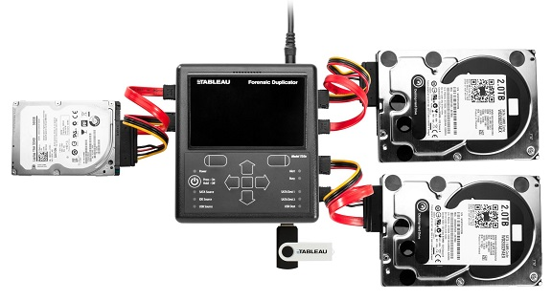
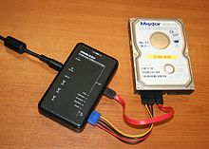
Traditional Imaging Process
Traditional imaging is performed on static drives (hard drives)
The computer system has been turned off and booted to a forensic imaging environment, or the disk has been plugged into an imager or examination workstation for duplication.
Use a write blocker to ensure data integrity (prevents corruption of data assuming FI Workstation has virus etc.)
Tableau Imager

Slide 25
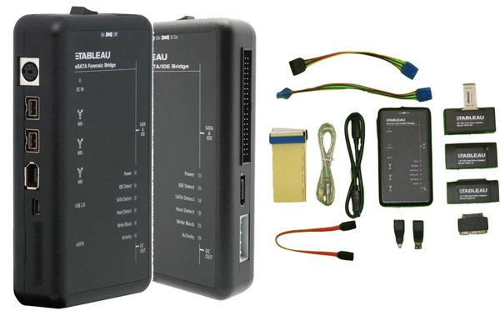
Traditional Imaging Process – cont.
Specialized hardware is used to prevent source media from being modified.
Hardware Write Blockers
A hardware write blocker is a device that sits in the connection between a computer and a storage unit.
It monitors the commands that are being issued and prevents the computer from writing data to the storage device.
It comes with many interfaces, such as ATA, SCSI, Firewire, USB, SATA etc.

Slide 26


Image Creation Tools
Commercial Software Tool:
Guidance Software - EnCase
AccessData FTK Imager
Open Source Tool (on Unix/Linux)
DC3dd
DCFLdd
dd

Slide 27
EnCase Evidence File
The EnCase evidence file is often called the image file.
It has the naming convention of ‘.Exx’. E.g. fraud.E01.
It contains the bit-stream image of the suspect drive, CRC (cyclic redundancy check) verification, case identification info (header) and an MD5 hash.
Header information as entered by the examiner become part of the evidence file and cannot be changed.

Slide 28
Physical Layout of EnCase Evidence File
The evidence file contains 3 basic parts:
Header
Data blocks
A bit by bit copy of the data blocks on the suspect media.
Checksum and Hash
32-bits verification (CRC – Cyclical Redundancy Check).
MD5 hash for checking of integrity.
Header: Contains case information | Header CRC | Data Block | CRC | Data Block | CRC | MD5

Slide 29
EnCase Evidence File Format
EnCase computes a CRC for every block of 64 sectors of data (32 Kbytes).
1 sector = 512 bytes
The 128-bit MD5 hash is computed for the entire data block section (exclude the CRCs).
MD5 hash verifies that both the imaged media and the evidence file contain the exact data.

Slide 30
EnCase Evidence File Format – cont.
When an ‘.Exx’ evidence file is added to a case, EnCase automatically verifies the CRC and re-computes hash value for the evidence data within the ‘.Exx’ file.
The verification process can only be successfully completed after both the MD5 acquisition and verification hash values match and no CRC errors are reported.

Slide 31
Challenges to Computer Evidence
Growth in electronic devices and the different platform
Smartphones, tablets, ipod, GPS devices etc.
Growth in storage size
How long does it take to search a 1 TB hard drive?
Where to store huge evidence files?
Challenges surrounding authenticity and integrity of evidence.
Was the data altered?
Was the program that generated the data reliable?
To ensure integrity of evidence, special hardware and software tools are used in digital forensic investigations.

Slide 32
Summary
Computer Forensic is the science of capturing, processing and investigating data from computers using a methodology whereby any evidence discovered is acceptable in a court of law.
Digital evidence is any probative information stored or transmitted in digital form that a party to a court case may use at trial.
A forensic image is a copy of original evidence generally collected by a tool that performs bit-level copying from one location to another.
Evidence acquisition must be done in a manner that protects and preserves the evidence.

Slide 33
Reference Books
Michael G. Solomon, K Rudolph, Ed Tittel, Neil Broom, and Diane Barrett, Computer Forensics JumpStart, 2nd Edition, Sybex.
Christopher L.T. Brown, Computer Evidence: Collection and Preservation, 2nd Edition, Course Technology (Cengage Learning).
EC-Council, Computer Hacking Forensic Investigator.
Guidance Software, Inc, EnCase Computer Forensics I & II.
Brian Carrier, File System Forensic Analysis, Addison- Wesley.
Jason T. Luttgens, Matthew Pepe, Kevin Mandia, Incident Response & Computer Forensics (3rd Edition), McGraw-Hill Education
Notes:
Publisher: Cisco Press, Thomson Learning

